Slide 1
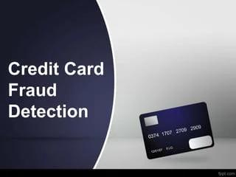
Mentorship Project
BY:
-Sudesh Kumari
-Amitesh Singh
-Manjeet Chaudhary
-Kanchan Maan
Under Guidance:
Subhadeep Das

Slide 2


Content
Introduction
What is Credit Card
Different stages in advancement of credit card
What is a credit card fraud
How does the credit card fraud can happen
Steps to avoid credit card fraud
Business impact
Why do we want to solve this problem
Data Collection and overview
Model fitting
Conclusion

Slide 3
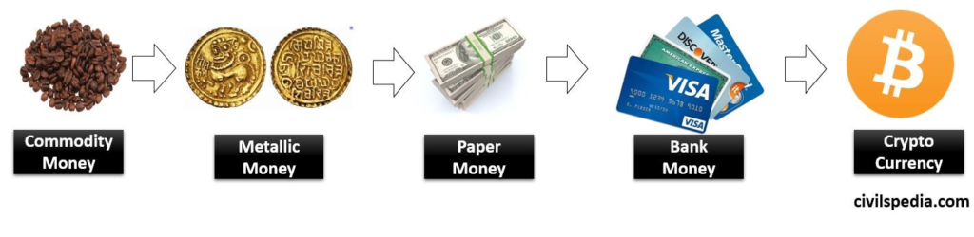
Introduction
With the development of technology, the digitalisation introduced in every sector it also includes banking sector. Now people can use there money through online transactions. but this also introduced a black side through which the banking fraud can happen.

Slide 4
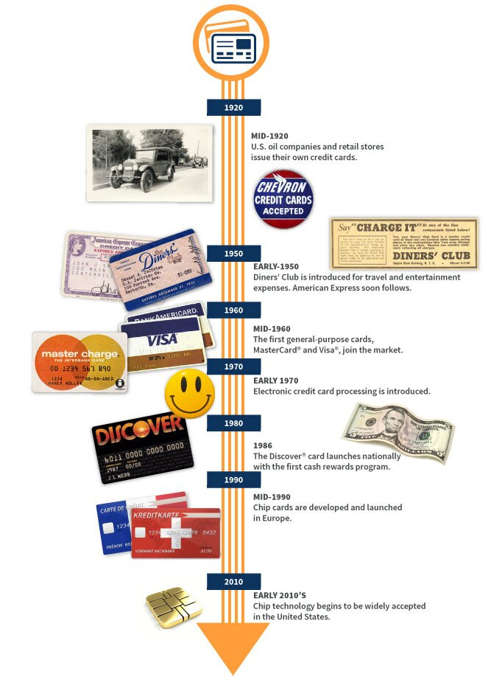
Different stages in advancement of credit card

Slide 5

What is Credit Card
A credit card is a plastic payment card issued by a financial
institution, usually a bank, that allows the cardholder to borrow funds to make purchases or pay for services on credit. It provides a convenient and widely accepted method of payment, enabling cardholders to
make transactions without carrying
physical cash.

Slide 6
But as a consequences of development , unfortunately it's misuse side is also growing and people use it for selfishness purposes.
Nowadays we encounter with the different cities & countries where the credit fraud arises.
Reports are indicating that credit card fraud has grown into massive, it also involves organised criminal network, operating internationally.

Slide 7
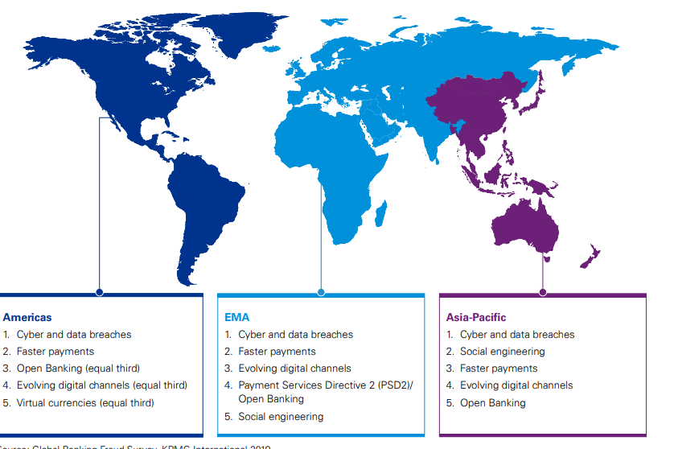
KPMG's Global banking survey was conducted between November 2018 and February 2019 across 43 retail banks, 13 of which are Asia-pacific, 5 in Americas and 25 are in Europe, the middle East and Africa region.
various kind of banking frauds happening in these regions as below

Slide 8
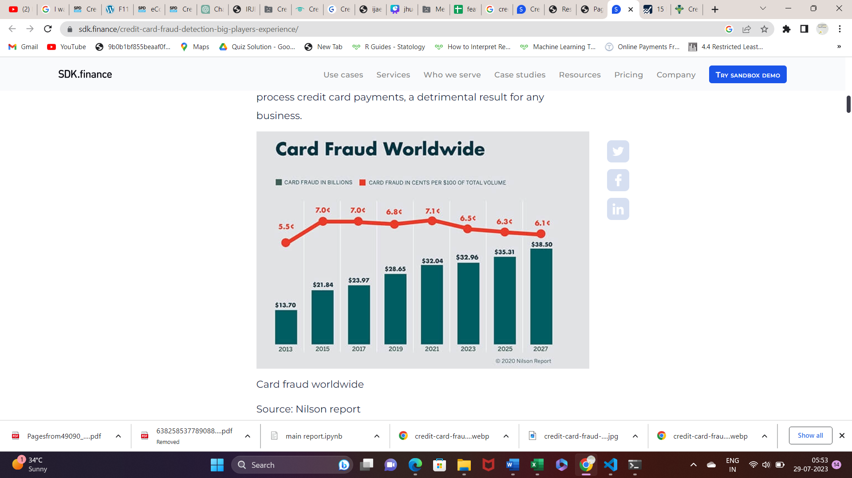
Here are the some insights how the fraud is growing continuosly year after year
A graph for the growing trends in frauds

Slide 9
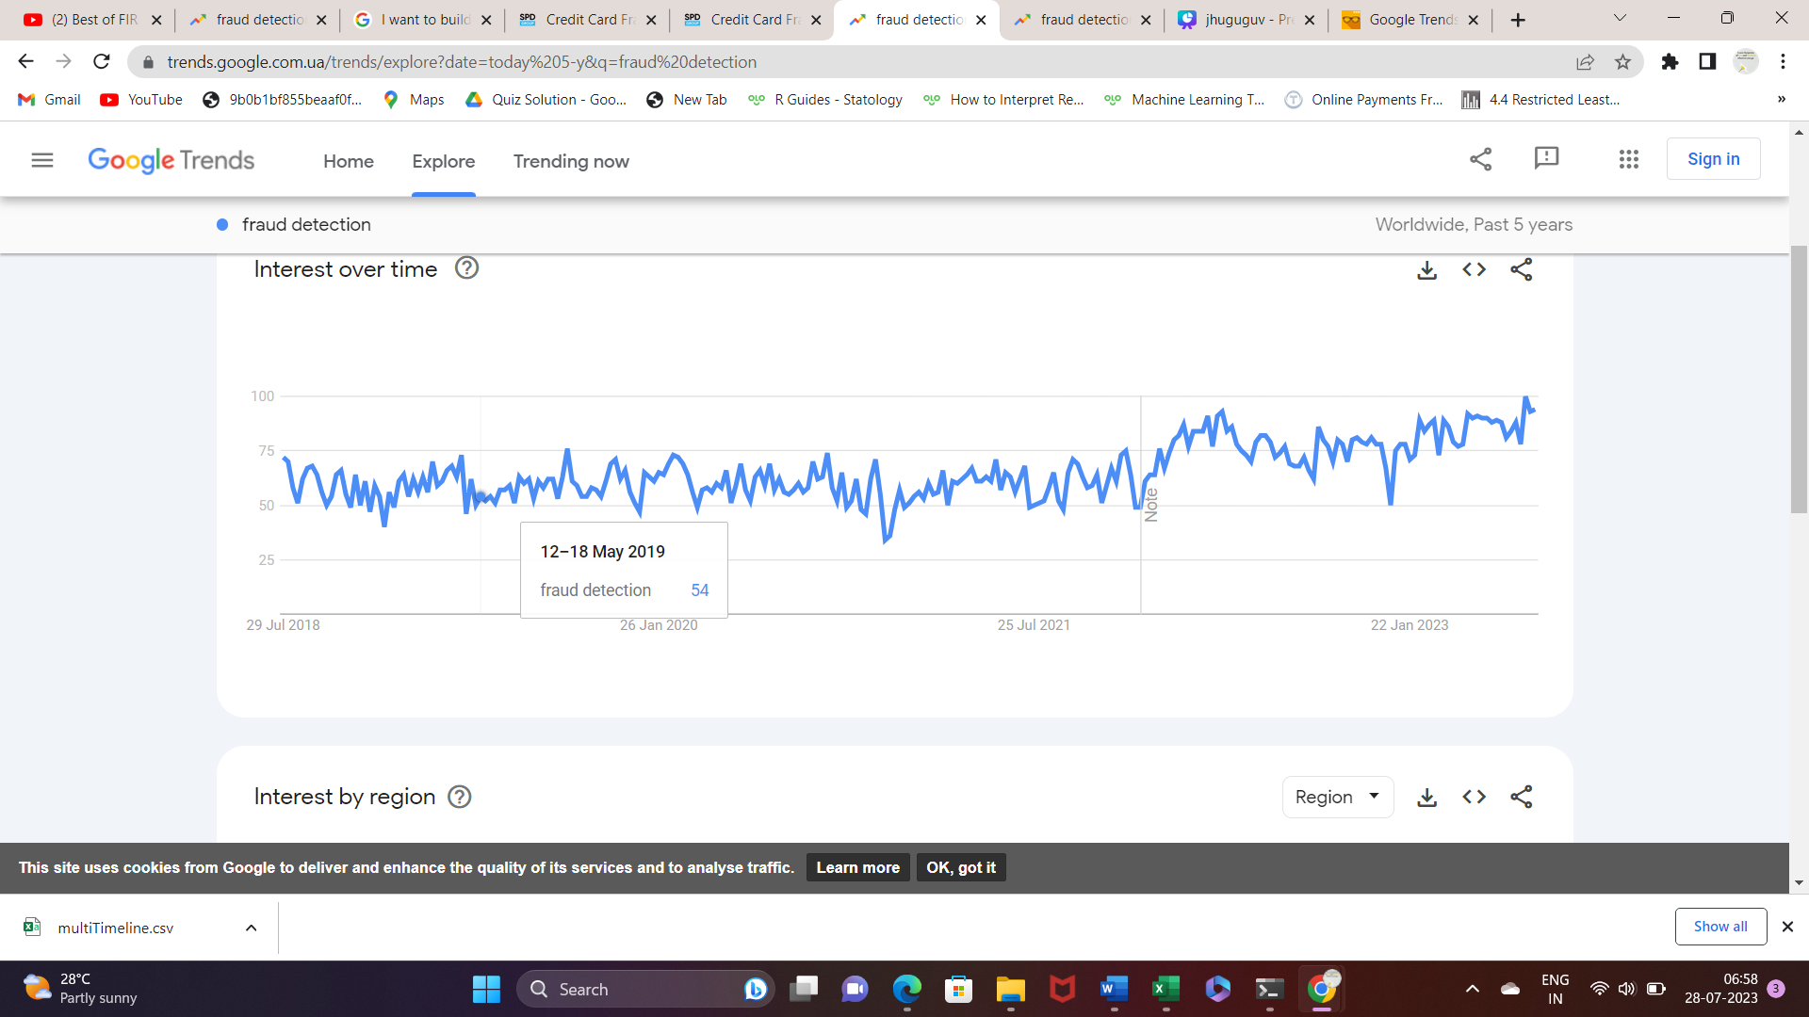
The Rising Trends of fraud detection:
As more and more businesses are facing credit card fraud and
identity theft,the popularity of “fraud detection” is rising in
Google Trends:

Slide 10

What is a credit card fraud?
Credit card fraud is an illegal act an individual commits to defrauding someone who is the actual credit card holder.
For example, the purpose might be to buy goods and services
or make payments to a third-party account not
authorized by the cardholder.

Slide 11
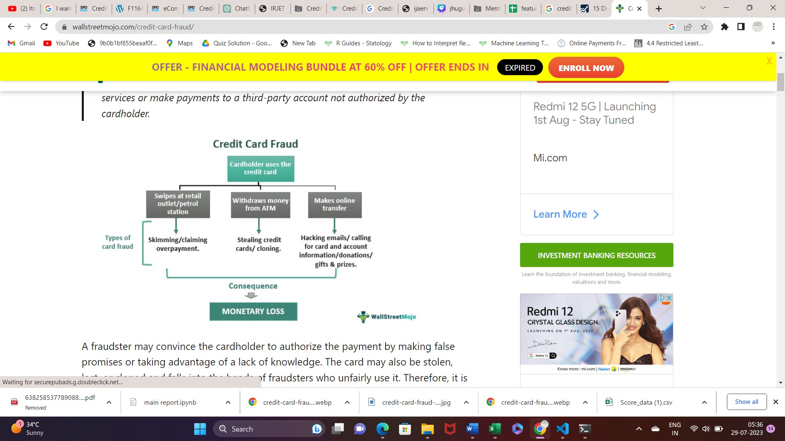
How Does Credit Card Fraud Can Happen?

Slide 12
Steps to avoid credit card fraud
Keep Your Card Secure
Beware of Phishing Scams
Use Strong Passwords
Update Security Software
Enable Transaction Alerts
Protect Personal Information
Use Secure Websites
Monitor Your Accounts

Slide 13
Business Impact
The business impact of the fradulent transactions can be significant and it effects both the financial institutions and its customers :
Financial loss
Repution Damage
Customer churn
Operational cost
Trust deficits with business partners

Slide 14
Why do we want to solve the problem ?
Financial Loss
Prevention
Enhancing
Economic
stability
Customer Trust and
Loyalty
Enhancing
Security
maintaining trust
to financial
institution

Slide 15
Data Collection and Overview:
The Dataset is taken from the kaggle website .
It contains the transaction of the customers during the session January 2016 to December2016.
The Dataset has 781208 number of transactions in which 12113 fraud occurs.
in which 'isFraud ' is our target variable and other colums are input variables.

Slide 16
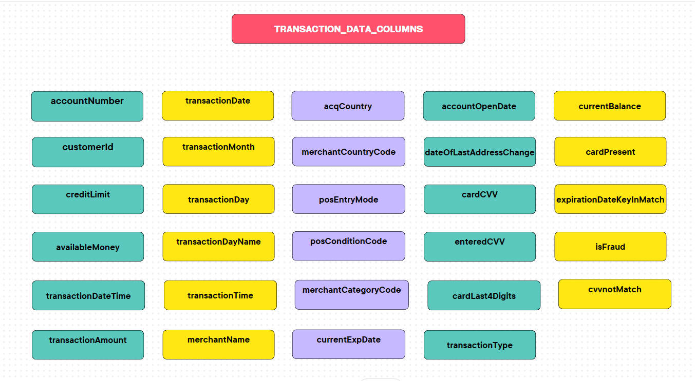

Slide 17
After that by using our original (raw feature ) data We have created some more features (current transaction features and Historical features). we call it feature_list' .
these are some of the created features :
transactionAmount', 'Days_accOpenDate', 'Days_lastAddChange',
'sum_amt_merN_7d', 'Hours_merN', 'sum_amt_pos_7d', 'count_pos_7d',
'count_merN_7d', 'sum_amt_merCatC_7d', 'Hours_pos', 'Hours_df_merCatC',
'Minutes_merN', 'Minutes_tAA', 'count_merCntryC_7d', 'Hours_tAA'.

Slide 18
Description of our model feature data :
sum_amt_pos_1h | sum of count of posEntryMode in last one hour
sum_amt_pos_6h | sum of count of posEntryMode in last six hour
sum_amt_pos_1d | sum of count of posEntryMode in last one day
sum_amt_pos_7d | sum of count of posEntryMode in last 7 day
prop_pos_vol_1h | count_pos_1h / count_total_1h , where count_total_1h means total no of all pos count in within 1 hr
prop_pos_vol_6h | count_pos_6h / count_total_6h , where count_total_6h means total no of all pos count in within 6 hr
prop_pos_vol_1d | count_pos_1d / count_total_1d , where count_total_1d means total no of all pos count in within 1 day
prop_pos_vol_7d | count_pos_7d / count_total_7d , where count_total_7d means total no of all pos count in within 1 day
prop_pos_amt_1h | sum_amt_pos_1h / sum_amt_total_1h , where sum_amt_total_1h means total transaction amount under all pos Entry Mode in within 1 hr
prop_pos_amt_6h | sum_amt_pos_6h / sum_amt_total_6h , where sum_amt_total_6h means total transaction amount under all pos Entry Mode in within 6 hr
prop_pos_amt_1d | sum_amt_pos_1d / sum_amt_total_1d , where sum_amt_total_1d means total transaction amount under all pos Entry Mode in within 1 day
prop_pos_amt_7d | sum_amt_pos_7d / sum_amt_total_7d , where sum_amt_total_7d means total transaction amount under all pos Entry Mode in within 7 day
Time Difference_pos | time difference between one kind of pos in format -- # days hh:mm:ss
Hours_pos | time difference between one kind of pos in format -- hh -- hours
Minutes_pos | time difference between one kind of pos in format -- mm -- minutes

Slide 19
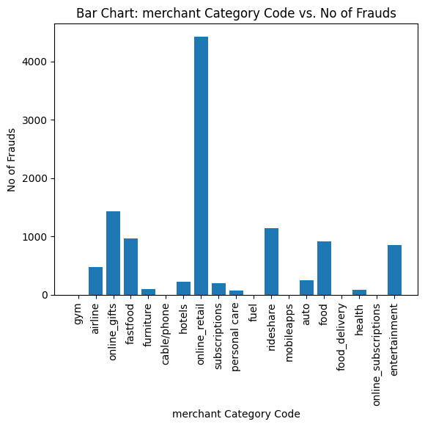
Some insights from our dataset
Maximum fraud occurs
in online retail category

Slide 20
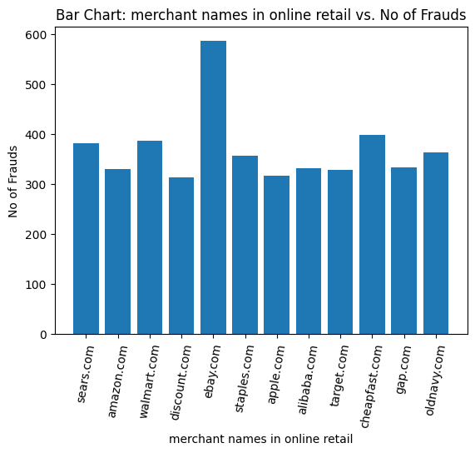
shows max fraud in online retail occurs due to it's one merchant ebay.com

Slide 21
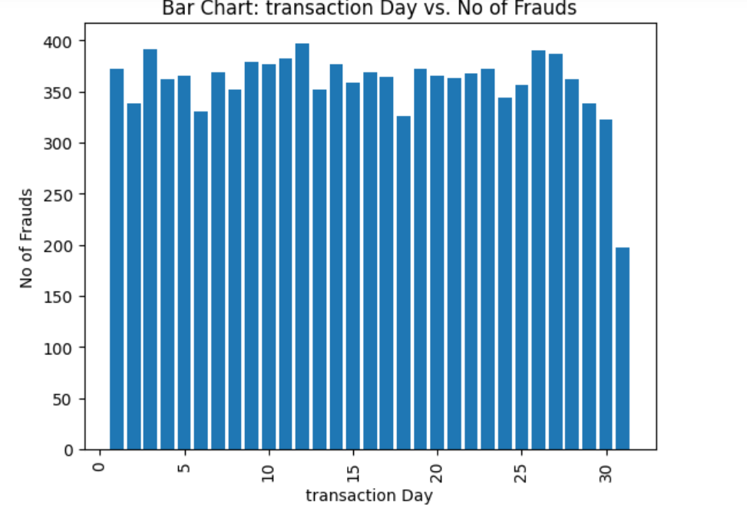
least fraud occur on 31 of each month

Slide 22
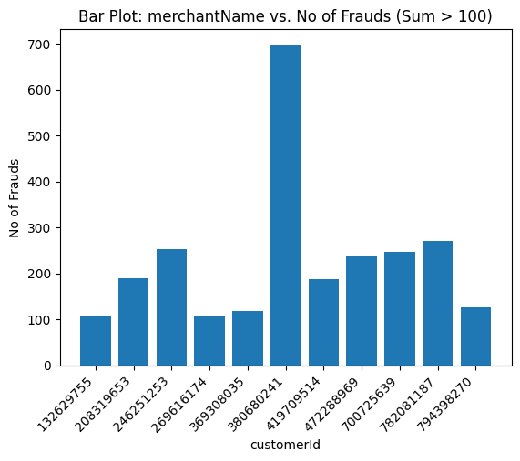
shows customers who faces more than 100 frauds in a year

Slide 23
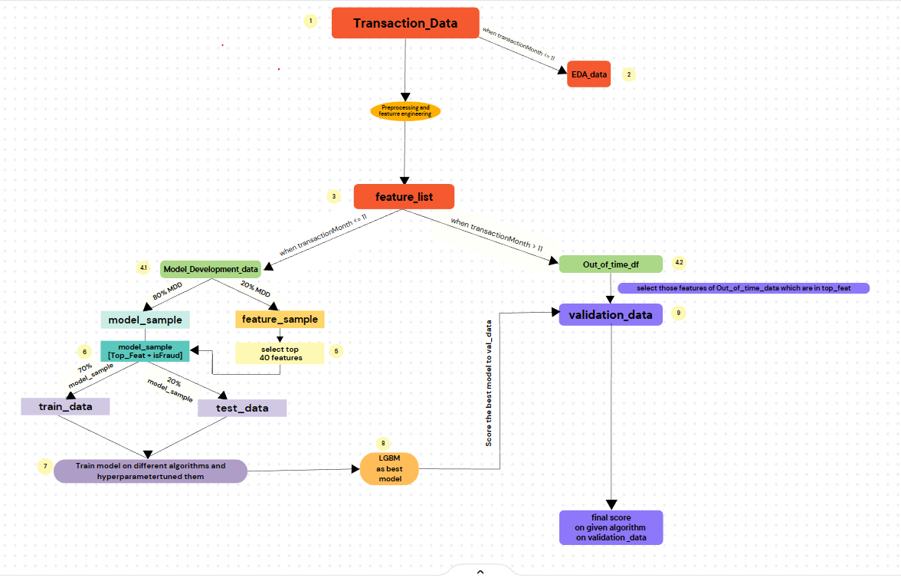
Chart of Model fitting

Slide 24
Model Fitting
we followed the following steps for Model fitting:
Step 1:
First, we divide our feature_list into two parts based on the month:
a) Model Development data:
It contains transactions that occurred from 01/01/2016 to 30/11/2016.
We use this data for model development.
b) Out of Time data:
It contains transactions that occurred in the month of 'December'.
We use this data as new data to evaluate and score our model.
Step 2:
Next, we further divide our model development data into two parts in a 30:70 ratio while stratifying on our target variable:
a) Feature data:
It contains 30% of the model development data.
We use this data to select some top important features among the 148 model features.
We employ different machine learning algorithms such as Logistic Regression, Light GBM, XGBoost, and CatBoost for this purpose.

Slide 25
2.Model data:-
It contains 70% of model development data. we use this data to train and test
our model.
Step 3:
Once we obtain the important features from the feature data, we refer to them as "Top Features." We then select only these top features from the model data and further divide them into training and testing datasets. Subsequently, we employ several machine learning algorithms, including Logistic Regression, Light GBM, XGBoost, and CatBoost, to fit the training dataset.
Step 4:
In this step, we choose the final model that provides the highest accuracy for both the training and testing datasets. In our case, the best-performing model is Light GBM.

Slide 26
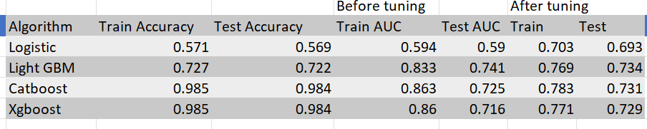
Algorithm used and their accuracies
Step 5:
After selecting the Light GBM Model, we proceed to validate our model on the Out of Time data and compute the predicted probability of outcomes that our model generates.
Using the predicted probability, we generate scores for all transactions. To achieve this, we utilize the pivot table feature of MS Excel and conduct further analysis. Through this process, we derive conclusions that aid in fraud prevention.
When a new transaction arrives, our model assigns a score to that transaction. we see If the score exceeds 701, we reject the transaction.

Slide 27
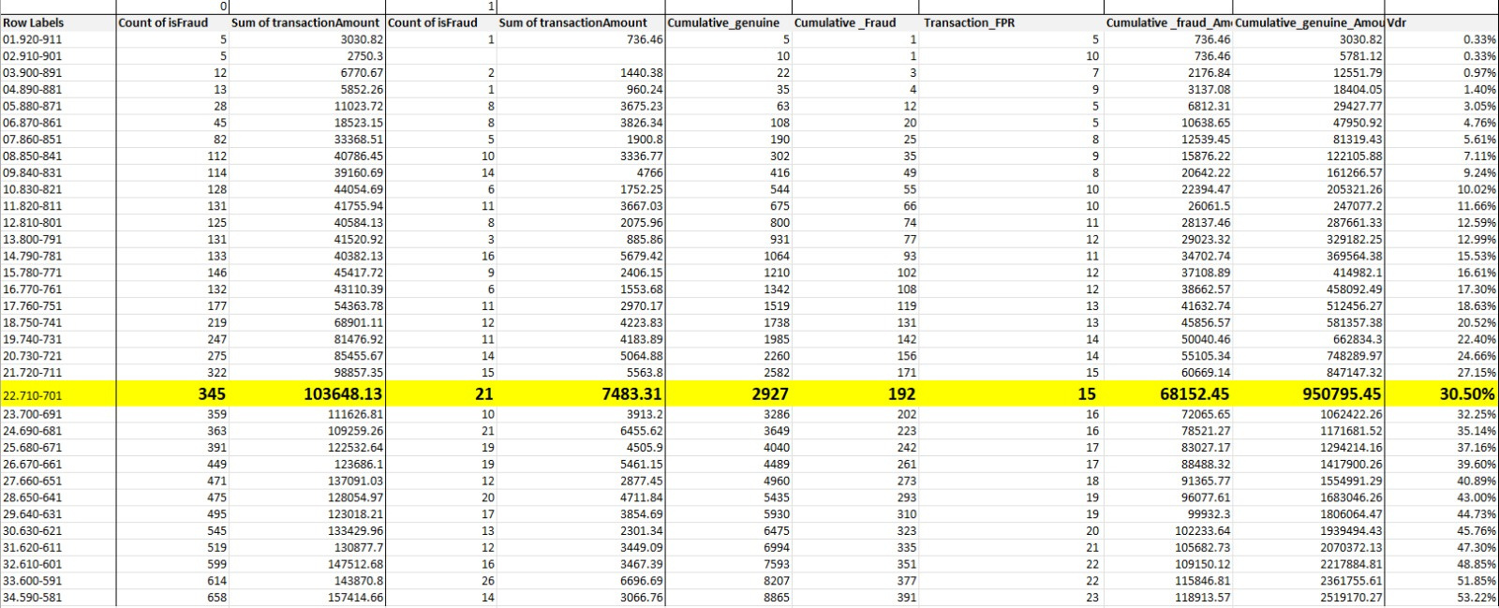
chart of fpr(false positive rate) and vdr(value detection rate)

Slide 28
Conclusion
By implementing our fraud detection model and declining transactions with a score greater than 701, we successfully reduced credit card fraud by 30.5%. We prioritize preventing fraud while considering that we may decline a small percentage of genuine transactions (15 genuine transactions to prevent 1 fraud).

Slide 29
THANK
YOU
Dada

